Slide 1
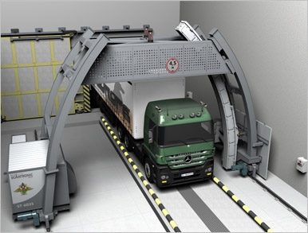
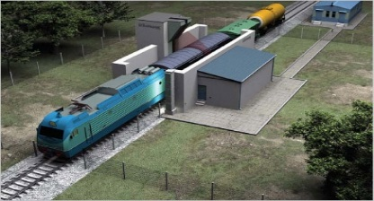
СТ-6035 СТ-2630Т
X-RAY INSPECTION SYSTEMS
ST-6035 ST-2630Т
MOSCOW, RUSSIA

Slide 2
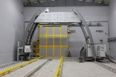
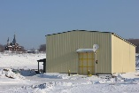
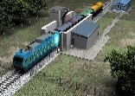
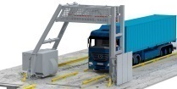
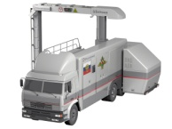
PRODUCT LINE OF «SCANTRONIC SYSTEMS»
INSPECTION SYSTEMS
Name | Purpose | Application field | Distinctive features
ST-6035 (ТУ 4276-001-68883689-2011) | For vehicle inspection | Inspection of loaded trucks and other vehicles and containers in ports, airports and state border check-points | Electron beam energy - 6/3.5 MeV Penetration in steel– 400 mm Determination of effective atomic number with accuracy ±1 for Zeff < 30 Discrimination of 4 groups of materials Evaluation of cargo weight in whole and its component parts with accuracy no worse 10%
ST-2630 Т (ТУ 4276-002-68883689-2012) | For freight train car inspection | Inspection of loaded freight train cars at train speed up to 70 km/h | Electron beam energy - 6/3.5 MeV Penetration in steel at train speed up to 70 km/h - no worse – 320 mm Penetration in steel at train speed up to 35 km/h - no worse – 350 мм Discrimination of 4 groups of materials Evaluation of cargo weight in whole and its component parts with accuracy no worse 10%
ST-2630 (ТУ 4276-008-68883689-2014) | Lightweight system for vehicle inspection | Inspection of loaded trucks and other vehicles and containers in ports, airports | Electron beam energy - 6.0/3.5 MeV Penetration in steel– 300 mm Discrimination of 4 groups of materials Evaluation of cargo weight in whole and its component parts with accuracy no worse 10% Throughput - up to 25 vehicles in hour
ST-2630M | Mobile inspection system for control of vehicles and sea containers | Inspection of loaded trucks and other vehicles, as well as containers in seaports, airports and state border check-points | Electron beam energy - 6/3.5 MeV Penetration in steel– 320 mm Discrimination of 4 groups of materials Evaluation of cargo weight in whole and its component parts with accuracy no worse 10% Throughput - up to 25 vehicles/hour

Slide 3
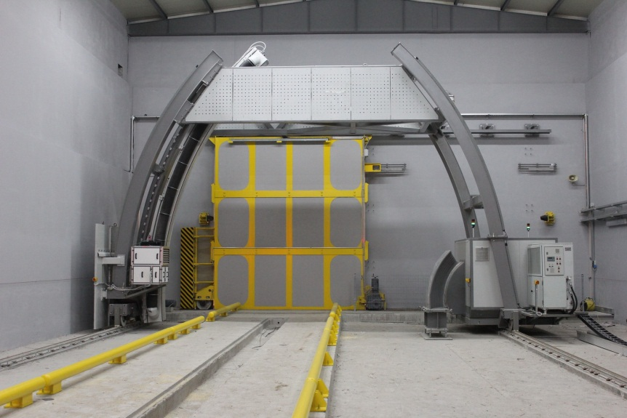
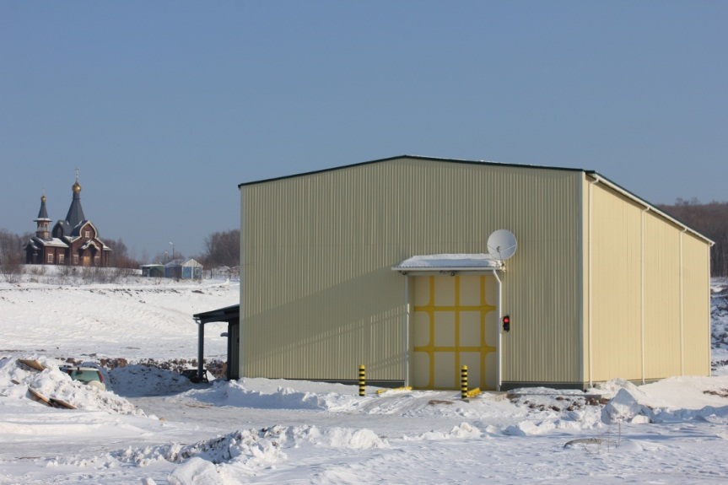
Inspection system SТ-6035
(ТУ 4276-001-68883689-2011)
LLC Scantronic Systems created the x-ray inspection system for vehicles and sea containers ST-6035 that is deployed at the Russian State Border check-point Pogranichniy, Primorsky Krai.
The Customer is “Federal Agency for the Development of the State Border Facilities of the Russian Federation (Rosgranitsa)”.
Due to its unique technical specifications the IS ST-6035 provides information about transported cargo without container opening and its manual inspection.

Slide 4
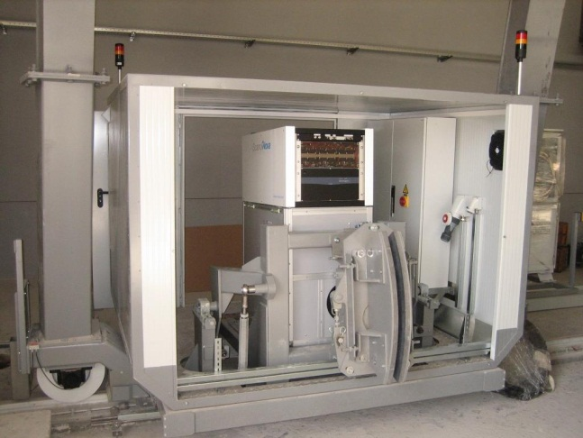
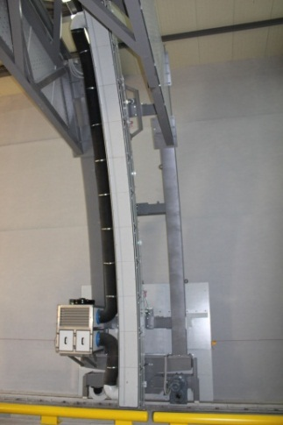
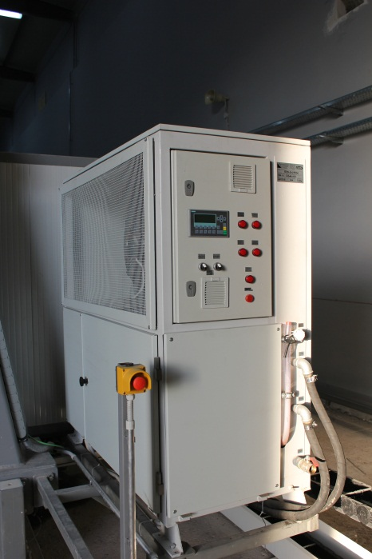
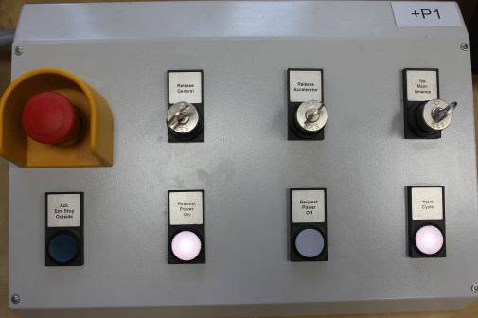
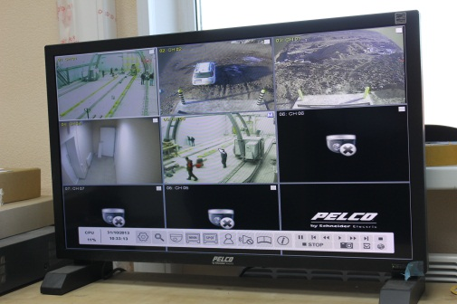
Inspection system ST-6035
The distinctive features of developed and deployed technological equipment are its principally new functional abilities in determination of physical structure of inspected cargo, which greatly facilitate work of operators and considerably raise effectiveness of inspection.
Basic components of the system: accelerator and detection system are developed on the base of production of Russian enterprises.
Using the IS ST-6035, a Customer gets a possibility to construct a distributed system of control and security, controlled from a common center, regardless of the remoteness of inspection points from each other. Obtained data is saved in a common database and can be used in the analytical work and for further training of operators.

Slide 5
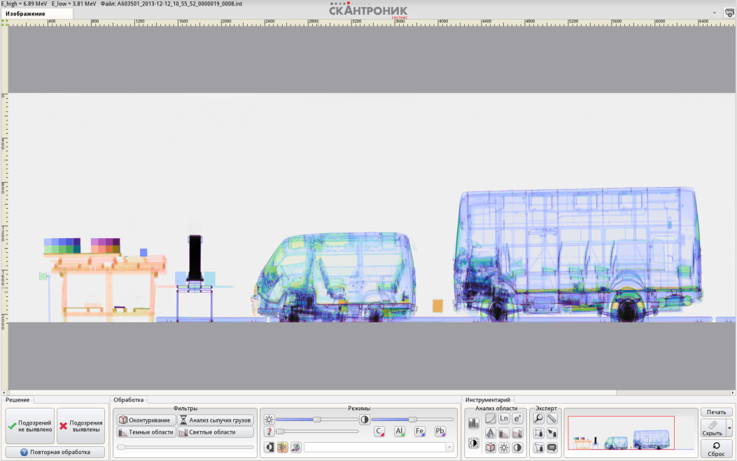
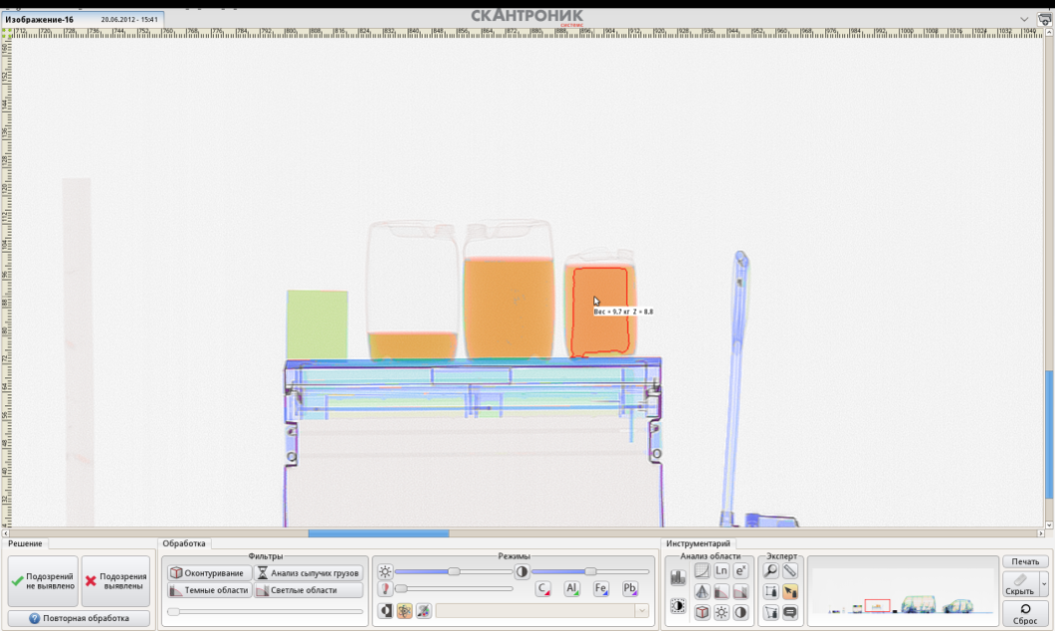
Results of ST-6035 test at State Border vehicle check-point «Pogranichniy» with participation of the State Customer
Organics 1<Z<10
Light metals/minerals 10<Z<20
Metals 20<Z<50
Heavy metals Z>50
High penetration in steel – 400 mm
High contrast sensitivity - 0.5%
Wire detection – 0.5 mm
Precise discrimination of groups of materials by their effective atomic number (±1 for Z_{eff})
Identification of group of heavy metals (gold, platinum, etc.)
Evaluation of cargo weight in whole and its component parts with accuracy no worse 10%

Slide 6
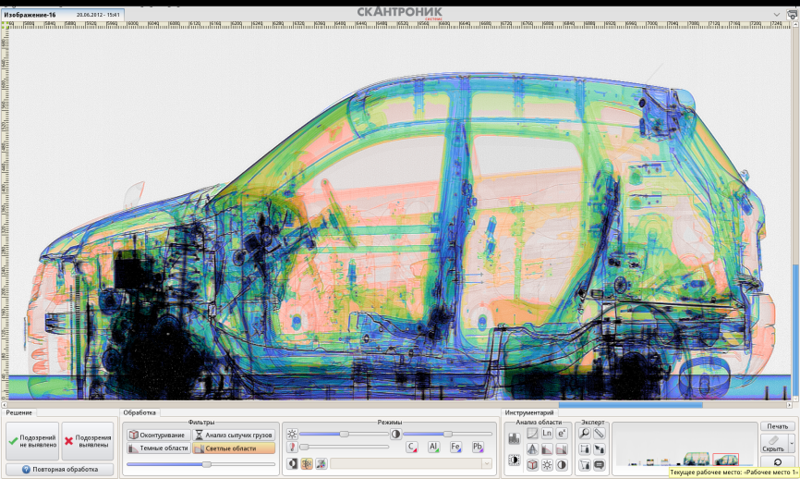
Basic parameters of ST-6035
 | Parameter | Value
1 | Electron beam energy | 6/3.5 MeV
2 | Maximal penetration in steel | 400 mm
3 | Detection of steel wire: without barrier with diameter with 100 mm steel barrier with 250mm steel barrier | no more 0.5 mm no more 1 mm no more 6 mm
4 | Contrast sensitivity | 0.5%
5 | Number of discriminated by Z groups of materials | 4
6 | Mass thickness of effective material discrimination | from 5 g/cm2 to 140 g/cm2
7 | Throughput | up to 25 veh./hour
8 | Maximal dimensions of vehicle | 20×3×4,5 (L х W х H)
9 | Maximal dose absorbed by an object in one scanning | lesser 60 µSv
10 | Annual dose for operators and population | lesser 1,0 mSv/year
11 | Dimensions of inspection hall for 20m-length vehicle | 14 х36.9 (WхL)
12 | Database capacity | 12 Tb
13 | Scanning speed | 36 m/min
14 | Consumed power | 60 kVA
Inspection system ST-6035 represents itself a complex of principally new scientific and technical solutions, which allows to realize discrimination of 4 groups of materials by their atomic numbers (with accuracy ±1 for Z≤30), and also weight evaluation of cargo and separate objects with error no worse 10%.

Slide 7
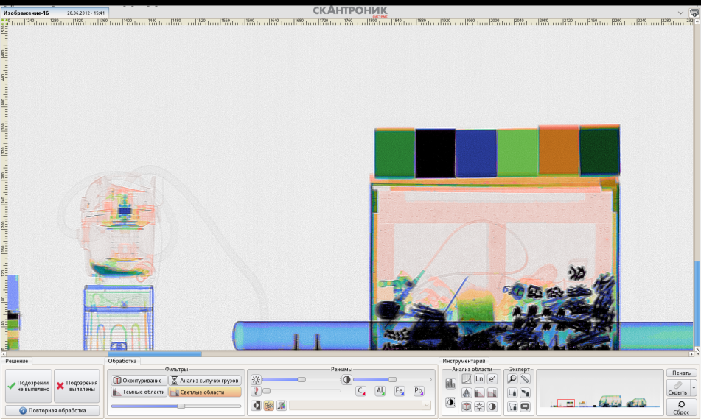
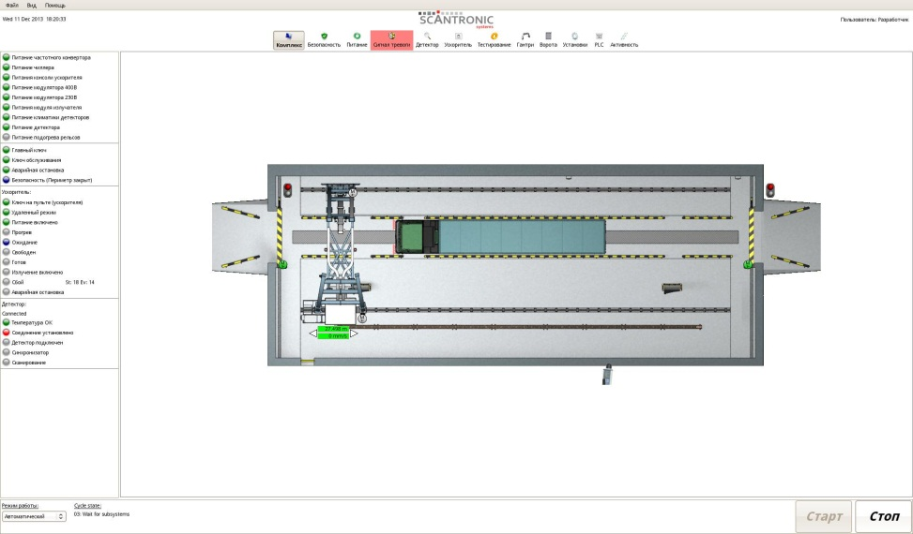
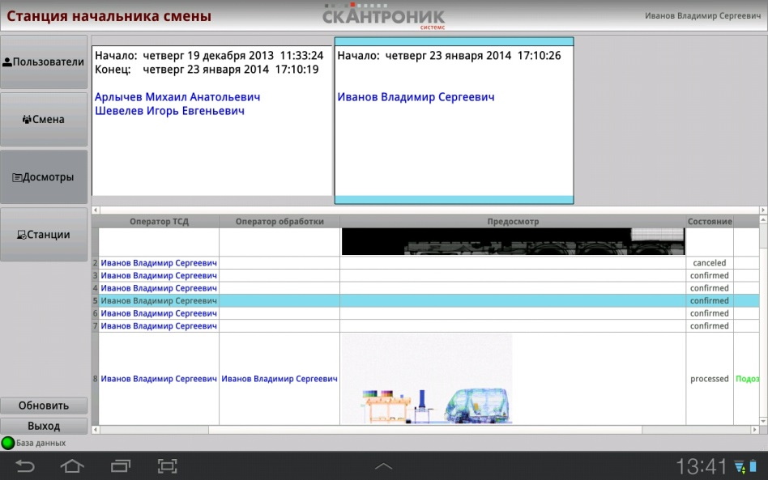
Software complex of ST-6035
Software is developed on the base of domestic version of OS Linux, taken as the base for national software platform. Functionality of the software complex was created with regard of specialist’s recommendations of the Russian Customs Academy and the Federal Customs Service of the Russian Federation that has allowed to develop user-friendly interfaces and maximally automated operator workstation.
During the software complex development there were used modern web-technologies that provided a Customer with ability of remote access to the system for its effective control and monitoring .

Slide 8
Inspection system for freight train cars ST-2630Т
(ТУ 4276-002-68883689-2012)
Due to innovative and approved technical solutions and technologies LLC «Scantronic systems» can propose to a Customer the train inspection system ST-2630T with wide range of abilities for fast and high quality inspection of cargo at high speed of train moving (up to 70 km/hour), which is achieved by using in the system of a domestic electron accelerator УЭЛР-6-1-Д-4-03 with pulse repetition rate up to 2000 Hz.

Slide 9
Train inspection system ST-2630Т
Usage in ST-2630 of an optical line-scan camera also allows receiving photo images of train cars and their matching with corresponding radioscopic images, what considerably facilitates work of operators of image analysis.
In the automatic system the special sensors are applied that provide radiation safety and fragmentation of X-ray images of separate train cars, their scaling and saving in the database.
The concept of ST-2630Т implies a possibility of its remote allocation and its operation in automatic mode with integration into the IT-infrastructure of a Customer. That implicates allocation of the technological equipment on a railway span, and processing of received information on a railway station or in the Customer offices.

Slide 10
Basic parameters of ST-2630Т
 | Parameter | Value
1 | Electron beam energy | 6/3.5 MeV
5 | Maximal penetration in steel at train speed up to 70 km/h | no worse – 320 mm
6 | Maximal penetration in steel at train speed up to 35 km/h | no worse – 350 mm
7 | Detection of steel wire: without barrier with diameter with 100 mm steel barrier with 250 mm steel barrier | no more 0.8 mm no more 2 mm no more 8 mm
8 | Contrast sensitivity, no worse | 2%
9 | Number of discriminated by Z groups of materials | no less 3
10 | Mass thickness of effective material discrimination | from 5 g/cm² to 120 g/cm²
11 | Train speed during inspection in high/low energy mode (without material discrimination) | up to 70 km/hour
12 | Train speed during inspection in dual energy mode (with material discrimination) | up to 35 km/hour
13 | Maximal cargo dimensions in freight train car | 4.48 m×5.3 m (WxH)
14 | Maximal dose absorbed by an object in one scanning | lesser 40 µSv
15 | Annual dose for operators and population | lesser 1,0 mSv/year
17 | Dimensions of safety zoneзоны | 50x40 м (LxW)
18 | Database capacity | 12 Тb
Usage in the system a radiation source with energy modulation altogether with a special calibration device allows discrimination of at least 4 groups of materials by effective atomic number and mass evaluation of cargo in whole and its separate parts with accuracy no worse 10%.

Slide 11
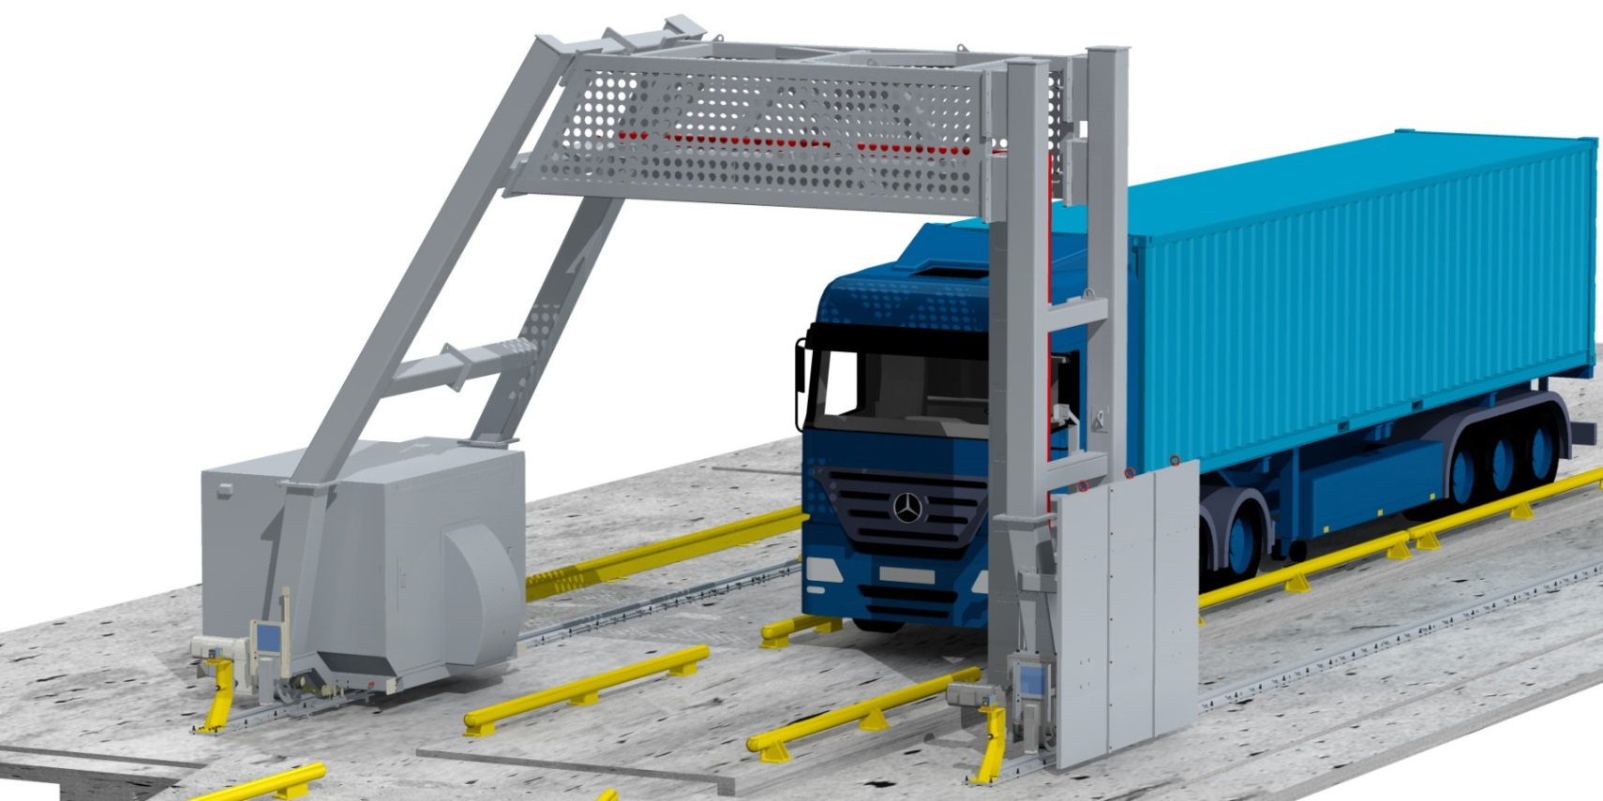
«Light» IS ST-2630
(ТУ 4276-008-68883689-2014)
Due to innovative and approved technical solutions and technologies LLC «Scantronic systems» can propose to a Customer a lightweight version of inspection system for vehicles ST-2630 with wide range of abilities for fast and effective cargo inspection at check-points. That is achieved by usage in the system a domestic linear accelerator with energies 6/3.5 МэВ with optimized radiophysical performances. The system does not require a radiation-protective construction and can be allocated in an easy erected building of sandwich-panels.

Slide 12
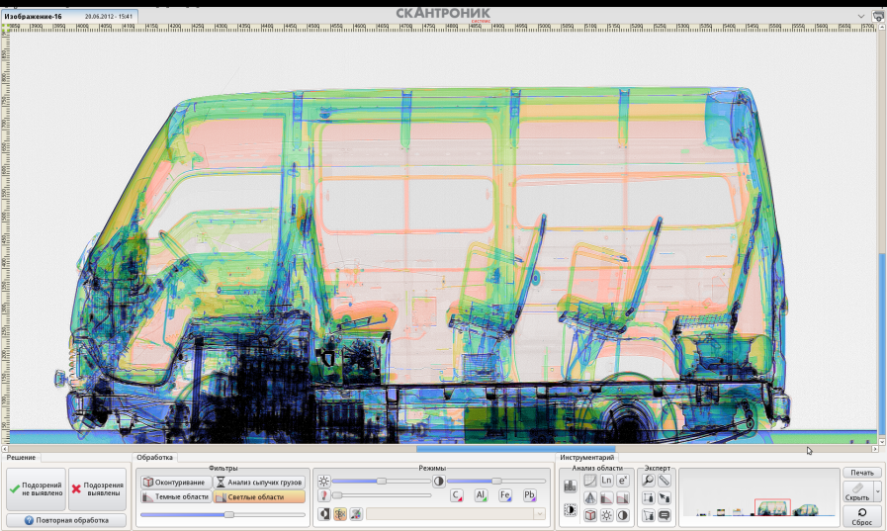
Basic specifications of IS ST-2630
 | Parameter | Value
1 | Electron beam energy | 6/3.5 МэВ
2 | Maximal penetration in steel | 300 мм
3 | Detection of steel wire: without barrier with diameter with 100 mm steel barrier | no more 0.8 mm no more 2 mm
4 | Contrast sensitivity | 1 %
5 | Number of discriminated by Z groups of materials | 4
6 | Mass thickness of effective material discrimination | from 5 g/cm² to 80 g/cm²
7 | Throughput | up to 25 veh./hour
8 | Maximal dimensions of vehicle | 20×3×4,5 (L х W х H)
9 | Maximal dose absorbed by an object in one scanning | lesser 2 µSv
10 | Annual dose for operators and population | lesser 1,0 mSv/year
11 | Number of sensitive elements in detector line | 1216
12 | Database capacity | 12 Tb
13 | Scanning speed | Upto 5 km/hour
14 | Consumed power | 25 kVA
Inspection system ST-2630 represents itself a complex of principally new scientific and technical solutions, which allows to realize reliable discrimination of 4 groups of materials by their atomic numbers, and also weight evaluation of cargo and separate objects with error no worse 10%.

Slide 13
Mobile inspection system ST-2630M
ST-2630M

Slide 14
Basic specifications of IS ST-2630 M
 | Parameter | Value
1 | Electron beam energy | 6/3.5 МэВ
2 | Maximal penetration in steel | 320 мм
3 | Detection of steel wire: without barrier with diameter with 100 mm steel barrier | no more 0.8 mm no more 2 mm
4 | Contrast sensitivity | 1,5 %
5 | Number of discriminated by Z groups of materials | 4
6 | Mass thickness of effective material discrimination | from 5 g/cm² to 80 g/cm²
7 | Throughput | up to 25 veh./hour
8 | Maximal dimensions of vehicle | 20×3×4,5 (L х W х H)
9 | Annual dose for operators and population | lesser 1,0 mSv/year
10 | Dimensions of safety zone | 50x30 m
11 | Climatic conditions | from -40°С to +45°С
12 | Operation time | 24/24
Mobile inspection system ST-2630M represents itself a complex of principally new scientific and technical solutions, which allows to realize reliable discrimination of 4 groups of materials by their atomic numbers, and also weight evaluation of cargo and separate objects with error no worse 10%.

Slide 15
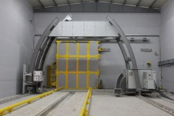
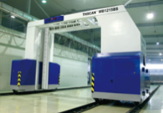
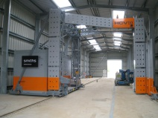
Comparative analysis of systems for vehicle inspection
Producer | IS model | Radiation energy, MeV | Penetration in steel, mm | Steel wire detection | Throughput, vehicles/hour | Scanning speed, m/min | Distinctive fetures
Scantronic systems (Russia) www.scantronicsystems.com | ST-6035 | 6/3.5 | 400 | 0,5 mm without barrier; 0,8 mm with 100 mm steel barrier; 6 mm with 250 mm steel barrier | 25 | 36 | 1. High reliable discrimination of 4 groups of materials by effective atomic number (with accuracy up to ±1). 2. Mass evaluation of cargo and its separate parts.
NUCTECH (China) www.nuctech.com | THSCAN MB1215HL | 6/3 | 340 | 0,8 mm without barrier; 2 mm with 100 mm steel barrier; 8 mm with 250 mm steel barrier | 25 | 24 | 1. Separation according to the criteria «organic-inorganic» (discrimination of 2 groups of materials). 2. Mass evaluation is absent.
Rapiscan Systems (USA) www.rapiscansystems.com | Rapiscan Eagle G60 | 6/3 | 370 | 0,8 mm without barrier; 2 mm with 100 mm steel barrier; 8 mm with 250 mm steel barrier | 25 | 24 | 1. Separation according to the criteria «organic-inorganic» (discrimination of 2 groups of materials). 2. Mass evaluation is absent.
Smiths-Heimann (Great Britan) www.smithsdetection.com | HCVG 6040 | 6/3,5 | 400 | 0,8 mm without barrier; 2 mm with 100 mm steel barrier; 8 mm with 250 mm steel barrier | 25 | 24 | 1. Separation according to the criteria «organic-inorganic» (discrimination of 2 groups of materials). 2. Mass evaluation is absent.

Slide 16
Thank you for attention
LLC Scantronic Systems headquarters E-mail.: info@scantronicsystems.com
Roshinsky proyezd, b. 19, Moscow, 115191, Russia

