Slide 1
Products and activity of JSC GERMANIUM

Slide 2
Content list
- ABOUT US
- GERMANIUM TETRACHLORIDE
- GERMANIUM DIOXIDE
- GERMANIUM POLYCRYSTALLINE ZONEREFINED
- METALLIC GERMANIUM
- GERMANIUM FOR OPTICal application
- GERMANIUM substrates for solar application
- QUALITY ASSURANCE
- Application fields

Slide 3
ABOUT US
JSC Germanium is the modern and high tech company which makes full production cycle of Germanium and its compounds: beginning from raw material and eternal volume and ending by finished production.
The annual production capacity of the Company is 20 tons germanium.
JSC exports more than 70% of following output products:
— Germanium tetrachloride;
— Germanium dioxide of different grades;
— Germanium polycrystalline zonerefined;
— Metallic germanium in form of granules and powder;
— Germanium blanks of different shapes for optical application;
— Polished germanium parts for optical application;
— Monocrystalline germanium substrates for solar application (since 2020).

Slide 4
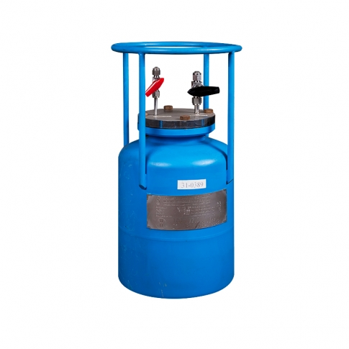
GERMANIUM TETRACHLORIDE
Colorless transparent liquid
Physical properties
Molecular weight | 214,6
Density (293° К),g/cm³ | 1,874
Boiling temperature (at 760 mm Hg), °С | 83,1
Melting temperature , ° C | (-49,5)
Solubility: in organic solvents (carbon tetrachloride, chloroform, benzol, ethyl alcohol, acetone and others)

Slide 5
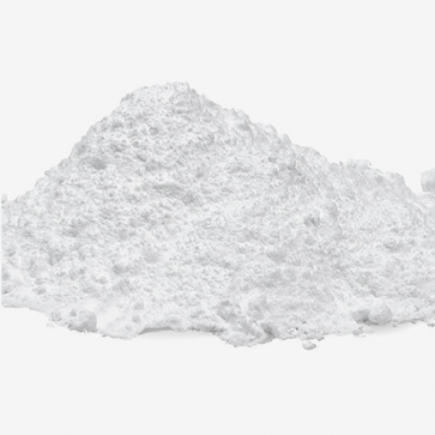
GERMANIUM DIOXIDE
GeO2
standard
Physical properties
Molecular weight | 104,6
Crystal structure | hexagonal
Density (293 К), g/cm³ | 4,280
Melting temperature, °С | 1116,0
Refractive coefficient | 1,7
GeO2
electronic
GeO2
catalysis
Fine
Soluble

Slide 6
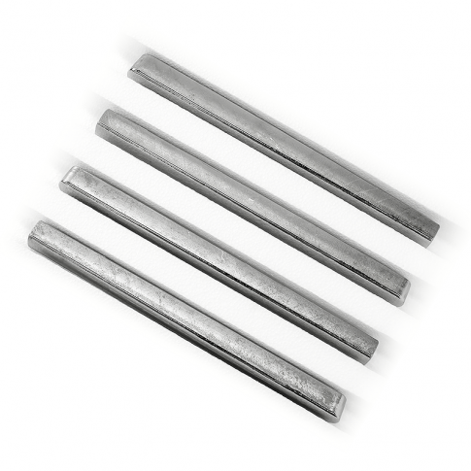
GERMANIUM POLYCRYSTALLINE ZONEREFINED
Physical properties
Atom weight | 72,6
Density (298 К), g/cm³ | 5,323
Melting temperature, °С | 937
Boiling temperature, °С | 2830
- Chemical purity — 6N (99.9999%)
- Resistivity of polycrystalline zonerefined germanium under t = 23° С not less than 47 Ohm·cm

Slide 7
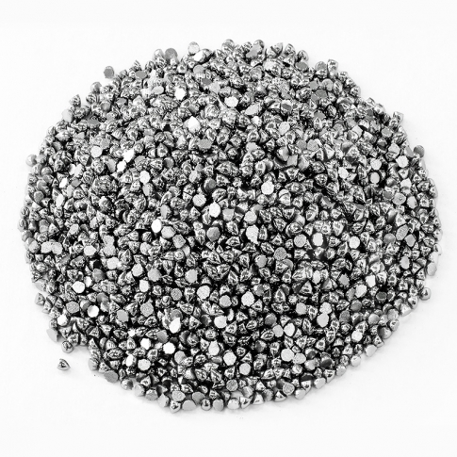
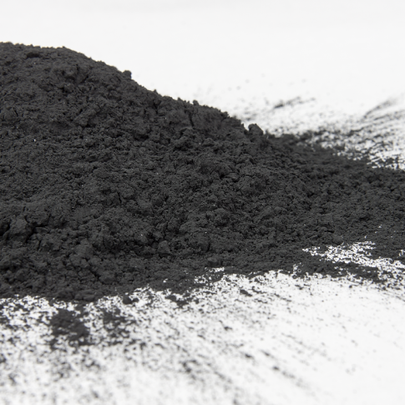
METALLIC GERMANIUM
In form of granules
Quality parameters | Analysis
Size, mm | 3-6
Chemical purity, sum, not less than, % weight (impurities Fe, Mn, Cu, Ni, Co, Ga, Al, Mg) | 99,999
In form of gray powder
Quality parameters | Analysis
Germanium content, not less than, % | 99,5
GeO₂ content, max, % weight | 0,5
Chemical purity, sum, not less than, % weight (impurities Fe, Mn, Cu, Ni, Co, Ga, Al, Mg) | 99,999
Grain size, mm | 10-50

Slide 8
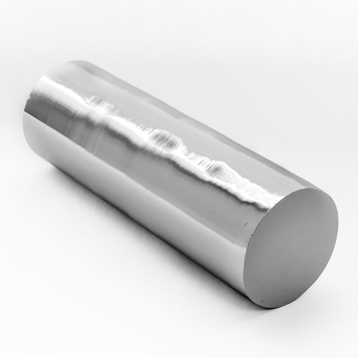
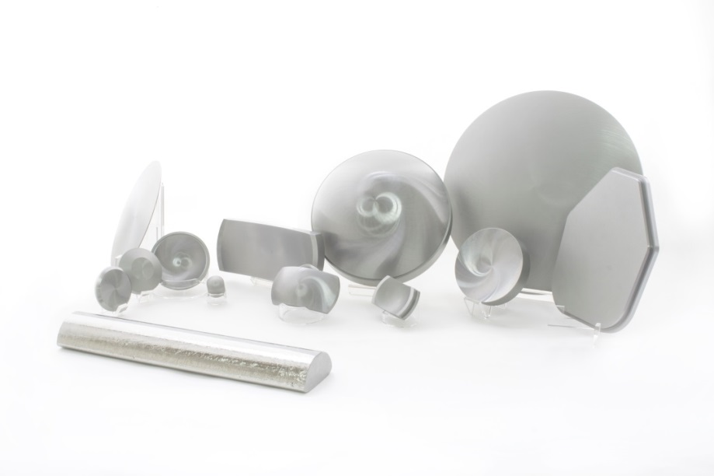
GERMANIUM FOR OPTICal applications
Optical properties
Index of refraction | 4.0048±0.0002 at 10.6 μm at 25ºC
Inhomogeneity of the index of refraction | ≤ 2·10⁻⁴
Temperature coefficient of the index of refraction | ≤ 4·10⁻⁴
Absorption coefficient, cm-1 | 0.03 см⁻¹ max на λ= 10.6 μm if t=25ºC
Transmission | 46% min at 4 μm, 45% min at 10.6 μm trough polished uncoated blank of 10 mm thickness
Material specification
Crystalline form | Monocrystalline; polycrystalline
Purity | ≥ 99.999%
Resistivity, Ohm•cm | 1÷5; 5÷40
Orientation | [111] ± 2º; [100] ± 2º
Conductivity Type | N

Slide 9
GERMANIUM FOR OPTICal applications
Parameter | Sizes | Tolerances
Diameter, mm | 10÷100 mm | 0.05 mm
 | 100÷200 mm | 0.1 mm
 | 200÷400 mm | 0.2 mm
Maximum diameter sizes, mm:
monocrystalline | 320 mm
polycrystalline | 440 mm
Thickness, sag, length and width, mm | 10÷100 | 0.05
 | 100÷200 | 0.1
 | 200÷400 | 0.15
Chamfer | 0.1÷0.8 | ±0.1 for diameter < 100mm
Surface finish, Ra, μm
Generated blanks | ≤ 1.5; ≤ 1.0; ≤ 0.5 μm
Plano blanks | ≤ 2.0; ≤ 1.5; ≤ 1.0 μm
Edge chips, mm | < 0.5 mm
ETV, mm | 10÷100 | 0.03
 | 100÷200 | 0.05
 | 200÷400 | 0.1
Polished
parts
Parameter | Value
Shape | Round; Rectangular; Oval
Diameter / Diagonal | from 8 to 300 mm
Thickness | from 0.4 to 25 mm
Chamfer | Protective / dimensional
Power/Irregularity wave @ 633nm | (5/1)
Parallelism (wedge tolerance), arc min | <2
Scratch/Dig | 60/40

Slide 10
GERMANIUM substrates for solar application
Parameter | Value
Crystallographic orientation | [110] + 6˚ -> [111]
Dislocation density | not more than 300 сm-2
Conductivity type | Р
Specific resistivity | 0.01 – 0.06 Оhm*сm
Diameter of wafer | 100 ± 0.5 mm
Thickness of wafer | 145 ± 10 μm
Size of primary flat | 32.5 ± 1.0 mm
TTV | not more than 10 μm
Bow | not more than 10 μm
Warp | not more than 20 μm
Chamfer | according to SEMI M79-0211
Working surface finish | polished, Ra > 0.01
Nonworking surface finish | generated

Slide 11
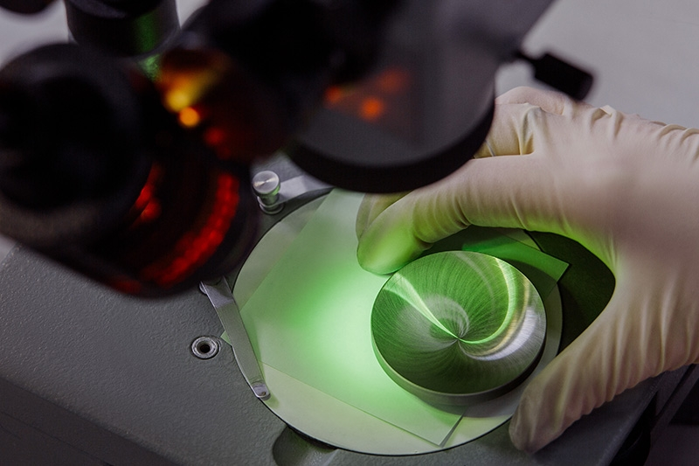
QUALITY ASSURANCE
The Production Control Laboratory is thus the guarantor of our product quality.
Our company’s vision emphasizes the importance of instilling quality in everything that we do.
Our quality control is carried out according to international standards and original methods developed by our laboratory professionals, which enable us to maximally automate data processing and provide us with operational control of production and quality management processes.

Slide 12
Application fields
- Radio-electronics;
- Infrared optics;
- Fiber-optic communication lines;
- Germanium based catalysts production;
- Devices for medical purposes;
- Alloys production;
- Elements for space solar cells.

Slide 13
Thanks for your attention!

