Slide 1
TAITRA
Taiwan External Trade Development Council
Date: January 1, 2020
Presenter: TWTC Moscow

Slide 2
OUTLINE
1
Facts about Taiwan
TAITRA Services
2
Taiwan’s Leading Industries
3

Slide 3
What are Taiwan’s unique advantages in today’s global marketplace?

Slide 4
1. Facts about Taiwan
①
Leading Trader in the World
Strong Innovation Capability
②
③
High Performing Industrial Clusters
④
Global Logistics Hub
Key Role in the Global Supply Chain
⑤

Slide 5
1.Facts about Taiwan Leading Trader in the World
World’s 4th best investment destination (Source: BERI)
4th in Asia-Pacific, Global Competitiveness Report 2018 (Source: WEF)
4th
4th
13th out of 190 economies for ease of doing business
(Source: World Bank, Doing Business 2019)
14th
13th
14th Best business environment in the world, 2014-2018
(Source: The Economist, Intelligence Unit forecasts)
18th
18th Largest exporter of goods in 2018
(Source: WTO)

Slide 6
1.Facts about Taiwan Top 10 Exports
（Amount: Million US dollar, Market Share: %）
01
Electrical and Telecommunications
Equipment and Parts
06
Organic Chemicals
(131,835M, 42.82%)
(11,315M, 3.68%)
02
Machinery, Mechanical Appliances &
Parts
07
Iron & Steel
(10,281M, 3.34%)
(34,476M, 11.20% )
03
Plastics & Articles Thereof
08
Vehicles & Components
(22,096M, 7.18%)
(9,828M, 3.19%)
Optical, Photographic, Precision,
Surgical Instruments & Accessories
Iron & Steel Products
04
09
(14,702M, 4.77%)
(8,397M, 2.73%)
05
Mineral Fuels, Oils & Waxes
10
Copper & Articles Thereof
(12,239M, 3.98%)
(4,269M, 1.39%)
Year: 2018 Jan-Dec
Source: GTA Database

Slide 7
1.Facts about Taiwan Strong Innovation Capability
World Economic Forum (WEF)
Ranked Taiwan as one of the 4 super innovators
2nd highest patent applications
5th highest international co-inventions
GERMANY
US
TAIWAN
Innovation Hub
SWITZERLAND

Slide 8
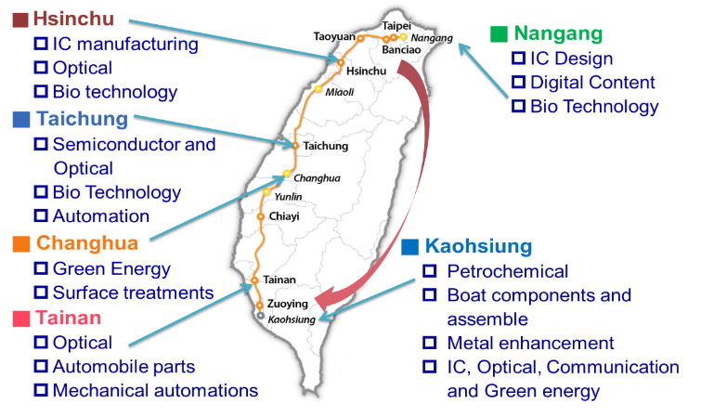
1.Facts about Taiwan High Performing Industrial Clusters
Ranked #5 in “State of cluster development” in 2017 and 2018
(WEF Global Competitiveness Report)
Taipei to Kaohsiung
120 mins Max.
Source: THSR, MOEA, 2018

Slide 9
1.Facts about Taiwan Taiwan’s Role in Global ICT Market
(Source: MIC 2017-2018)

Slide 10
1.Facts about Taiwan Global Logistics Hub
Taiwan is in the heart of Asia Pacific
Seoul
Tokyo
Shanghai
Average flight time to 6 major cities
2.33 hrs
Hong Kong
Taiwan
Manila
Singapore
Average navigation time to 5 major ports
54 hrs

Slide 11
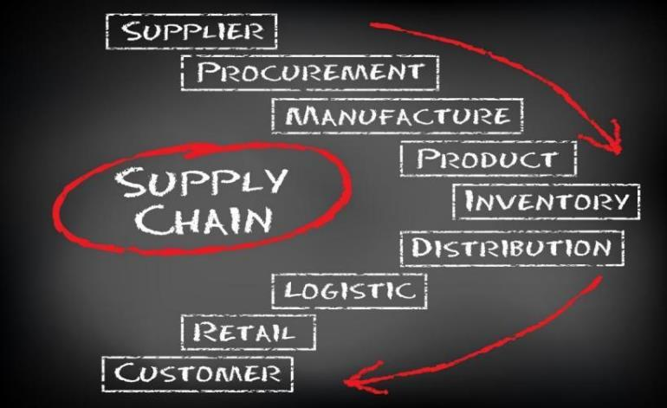
1.Facts about Taiwan Key Role in the Global Supply Chain
Taiwan Holding the Global Supply Chain Together

Slide 12
OUTLINE
1
Facts about Taiwan
2
TAITRA Services
Taiwan’s Leading Industries
3

Slide 13
Taiwan's Foremost
Trade Promotional Organization
A well-coordinated trade promotion and information network to help your business connect to the global market
5
Offices
in Taiwan
63
Offices
worldwide
1970
Founding year
1300
Specialists

Slide 14
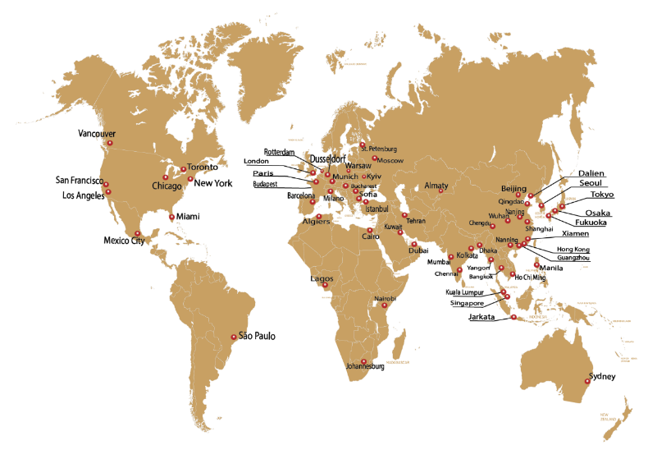
Taiwan’s Foremost
Trade Promotional Organization
TAITRA’s Global Network
Tel Aviv
Colombo
63
Overseas
Offices

Slide 15
Taiwan’s Foremost
Trade Promotional Organization
100/year
Seminars on
Trade-related Topics
4,000/year Graduates of
intl’ trade programs
40/year
Taipei international trade shows
300/year
Overseas trade promotion events
186,160/year
2018 International visitors & buyers to trade events

Slide 16
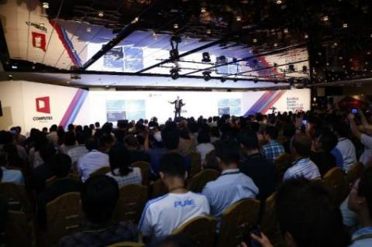
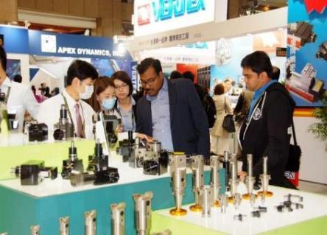
2. TAITRA Services Taiwan International Trade Shows
TAITRA organizes trade groups to participate in 40+ international trade exhibitions held overseas annually. Over 1,000 Taiwanese enterprises have had the opportunity to participate in these events.

Slide 17
2. TAITRA Services 2019 Taiwan International Trade Shows
The following is a few selected exhibitions, does not include all 2019 Taiwan Trade Shows
01
Taipei Int'l Machine Tool Show
06
Medical Taiwan
(2019.3.4-9)
(2019.6.27-30)
02
Taipei Cycle
07
Taiwan International Smart IoT Show
(2019.3.27-30)
(2019.8.21-8.23)
Taiwan Int'l Plastics, Rubber &
Composites Show
03
Taiwan AMPA
08
(2019.4.24-27)
(2019.8.21-24)
04
Computex Taipei
09
Taiwan Innotech Expo
(2019.5.28-6.1)
(2019.9.26-28)
05
Taipei International Food Show
10
Kaohsiung Food Show
(2019.6.19-22)
(2019.10.24-27)

Slide 18
2. TAITRA Services Taiwan Expo
The Expo aspires to build long-term relationships between Taiwan and its ASEAN neighbors. In addition to showcasing products, parallel business meetings and industry forums are also held to encourage B2B interaction and cultural exchange, as well as welfare activities.

Slide 19
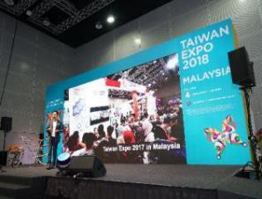
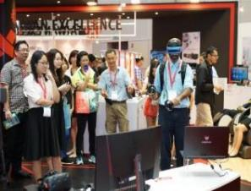
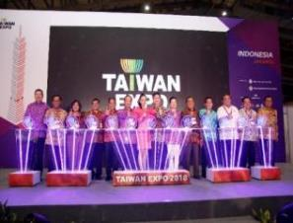
2. TAITRA Services Taiwan Expo
01
Taipei Expo in India
04
Taipei Expo in Indonesia
(2019.5.16-18)
(2019.9.26-28)
Taipei Expo in Malaysia
05
Taipei Expo in Philippines
02
(2019.7.05-06)
(2019.11.08-09)
03
Taipei Expo in Vietnam
(2019.8.08-10)

Slide 20
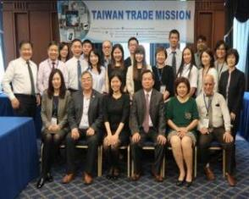
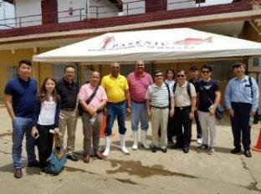
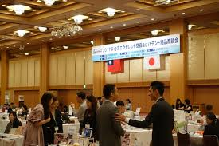
2. TAITRA Services Trade Missions
TAITRA organizes trade missions to visit various cities around the world to promote the representative industries of Taiwan.
118/year
2018 Trade Missions
99,575/year
2018 International Buyers to Trade Missions

Slide 21
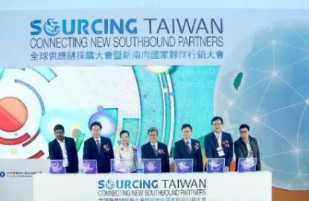
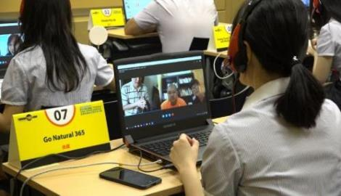
2. TAITRA Services Procurement Meetings
(Foreign Buyers and Taiwanese Suppliers)
14,529/year
2018 Procurement Meetings
101,657/year
2018 International Buyers of Procurement Meetings

Slide 22
2. TAITRA Services Online Trade Service - Taiwantrade
iDealEZ
Online Small Order Services
Trading Post
Post your Sell/Buy offers and get quotations
Global Partnership
Cooperate with global e-Commerce platforms
Localized Catalogs
Available in 13 languages
Request for Quotations
Find suppliers based on your requirements
Multi-Platform
Designed for an optimized experience on all devices
iMeeting
Meet suppliers online
via videoconferencing
Taiwantrade is Taiwan’s top B2B Platform, bridging global buyers to quality Taiwanese suppliers

Slide 23
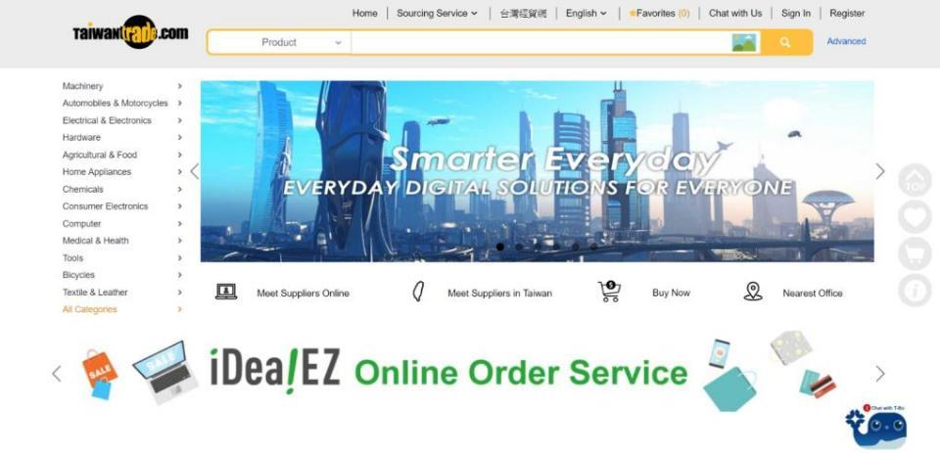
2. TAITRA Services Taiwantrade
E-trading Hub-Taiwantrade

Slide 24
OUTLINE
1
Facts about Taiwan
TAITRA Services
2
Taiwan’s Leading Industries
3

Slide 25
Taiwan’s World Leading Industries

Slide 26
3. Taiwan’s Leading Industries Leading market shares
(Products/Production value in global market share)
1
2
3
4
5
Mother Board
Laptop
Cable CPE
Wafer Foundry
WLAN
89.1%
83.3%
77.11%
73.16%
67.14%
6
7
8
9
10
IC Packaging & Testing
Functional Fabrics
Mobile Device
Optical Lens
DSL CPE
PND
65.4%
57.8%
55.84%
50.81%
50%
Year: 2017
Source: ITIS

Slide 27
3. Taiwan’s Leading Industries ICT – Semiconductor
TSMC+UMC=65%
TSMC Ranked 1st with an estimated market share of 56.1%.
In terms of revenue, TSMC, GLOBAL FOUNDRIES, and UMC took 1st, 2nd, and 3rd place, respectively.
Data source: TrendForce (2018/05), TAITRA

Slide 28
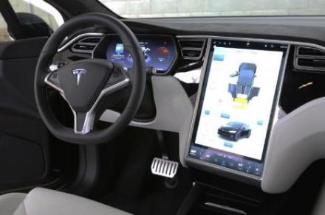
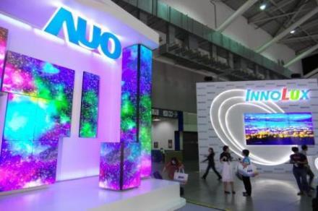
3. Taiwan’s Leading Industries ICT – Flat Panel
Major role in the global automotive display market
Strong capability in manufacturing customized panels with excellent quality
Key component in the smart IoT market
AU Optronics and INNOLUX are in the supply chain of many tier 1 system integrators
Data source: IHS Markit (2018), TAITRA

Slide 29
3. Taiwan’s Leading Industries ICT – Communication
WLAN
76%
Cable
Terminal
4G Terminal
& module
IP STB
77%
46%
41%
Rank 1st
Rank 1st
Rank 1st
Rank 1st
xDSL
Terminal
52%
Mobile Phone
3.7%
Rank 1st
Rank 4th
Data source: IEK (2018/05), TAITRA

Slide 30
3. Taiwan’s Leading Industries Smart Solutions
IoT Development Progress
Taiwan's position
7,353 IoT-related startups in 2017, up 1,406 from 2016 (23.6% increase).
Output value to reach US$56 billion by 2020, accounting for 4.7% of global output.
Source: GrowthEnabler Analysis

Slide 31
3. Taiwan’s Leading Industries Smart Solutions
Marketing promotion strategies & implementation
01
Integrate resources,
expand our services
Understanding the exporting demands of systems for public association and suppliers’ by expanding smart city alliance
2019
Visiting group of smart health
IoT Asia in Singapore
02
TAIWAN EXPO 2019 in India, Malaysia
Reinforcing international connection, opening global opportunities
- Attending international exhibition to assist Taiwanese suppliers for opening the international market.
Smart City Development Community – invite buyers from smart solutions(transport, healthcare, retail, domestic, etc.) and organize Taiwan’s system integration companies for one-on-one meeting and visit applied fields.
03
Smart city market survey in Thailand and Vietnam
Focusing target market to developing opportunities
- Doing market survey to develop local opportunities of smart solution for Taiwanese suppliers

Slide 32
3. Taiwan’s Leading Industries Machinery
4
Machine Tool
4
Export ranking in the world
Wood Working Machinery
Total Output of Taiwan Machinery: US$365 Billion
70 %~80%
of Taiwan machinery products are exported.
7
Plastics & Rubber Machinery
8
Textile & Sewing Machinery
15
Taiwan Machinery
Source: World Trade Atlas 2017; Taiwan Association Machinery Industry

Slide 33
3. Taiwan’s Leading Industries Machinery
Competitive advantages
Supply chain conformity and integration with electronics and ICT industries.
ICT
Applications
Smart
Manufacturing
Industry 4.0
High Quality
Prompt
Delivery
After-sales
Service
Customization
Strong Industrial
Cluster
Competitive Prices
Eco-friendly Designs

Slide 34
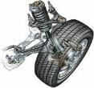
3. Taiwan’s Leading Industries Auto Parts
2018 Taiwan Auto Parts Exports
– Main Categories
Top 5 Export Items
Vehicle Components
Body Parts
Electrical Lighting
Tires
Road Wheel Parts
Most of the above items common
to the collision repair market.
3. Famous Taiwanese Suppliers:
Electrical Lighting: TYC Brother, DEPO
TYRES: KENDA, CHENG SHIN (MAXXIS)
WHEEL: SuperAlloy Co.

Slide 35
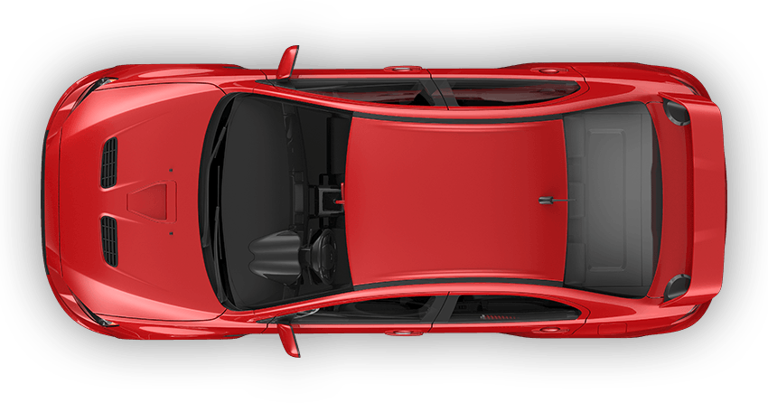
3. Taiwan’s Leading Industries Auto Parts
Future Auto Industry Development Trend
Energy Saving & Environmental Friendly
Lightweight Material+
Module Parts
Safe & Smart
Environmental protection drives towards upgrading
Electronic parts call for sensors, motors to improve efficiency and accuracy
Use high-strength materials such as carbon fiber or composite metals.
Introduction of modular design of components leading to cross vehicle systems, brands.
Combining sensors, computing, and various components to build safety.
Employ ADAS, vehicle networking system.

Slide 36
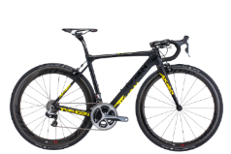
3. Taiwan’s Leading Industries Bicycle
Think Cycling, Think Taiwan!
%: Market share of the global high-end market
2 Well-known Brand
Handlebar: 30%
Pedal: 70%
Saddle: 50%
Chain: 80%
Rim: 55-60%
Hub: 20%
Carbon Fiber Frame: 25%

Slide 37
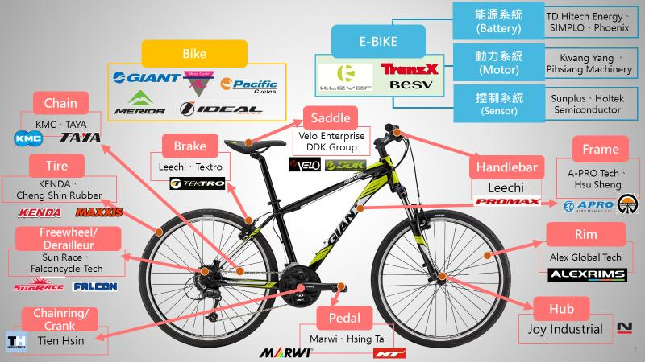
3. Taiwan’s Leading Industries Bicycle
Taiwan Major Bikes & Parts Manufacturers

Slide 38
3. Taiwan’s Leading Industries Overview of Taiwan Textiles
2018 Scale
2018 Export Products
Export Value: US $100.77 billion (+0.01%)
Import Value: US $36.81 billion (+9%)
Competitive product: Functional fabrics
Taiwan accounts for 70% of the world’s output of functional fabrics, and is the 6th largest textile exporter globally.
Miscellaneous
4%
Apparel
5%
Fiber 8%
Yarn 17%
From Functional Fibers & Fabrics
to High‐tech Industrial Textiles
Fabric 66%

Slide 39
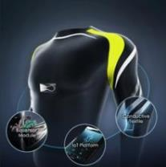
3. Taiwan’s Leading Industries Strengths of Taiwan Textiles
Functional
Textile
Athleisure
Smart
Textiles
Eco
Textiles
Athletic +Leisure
More than 70 % of the world’s outdoor sportswear is currently made using performance textiles from Taiwan.
Nike, Adidas and Under Armour source their functional textiles from Taiwan.
Athletic Leisure
Not just sportswear confined to a studio or gym, but also fashionable clothes that can be worn in many occasions.
A fashion trend of the 21st century.
Fiber + Electronics
The Taiwan Smart Textile Association was jointly initiated by the textile, electronics, and telecommunications industries in March 2018.
Smart textiles market scale will reach US$9.3 billion by 2024.
Eco-friendly material
Recycled plastic bottles
Bamboo charcoal yarn
S.Cafe fabric
Corn fabric
Milk Protein fiber
Spider Web Lace Fabric

Slide 40
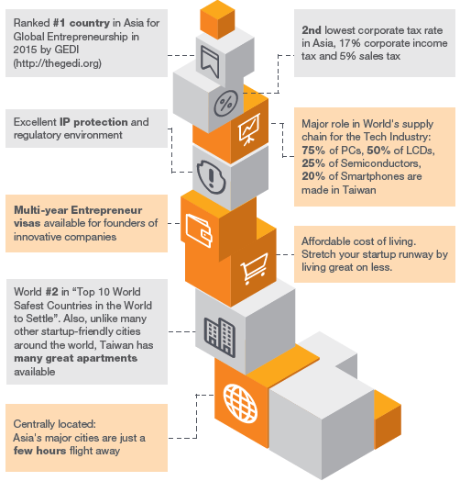
3. Taiwan’s Leading Industries Startup
Why Choose Taiwan?
A hotspot for hardware development and production.
The history of technology innovation has positioned the island to become the launch site for startups.
Taiwan is home to many public and private startup incubators and accelerators where entrepreneurial-minded individuals can turn for funding and mentoring.
Source: WEF

Slide 41
3. Taiwan’s Leading Industries Startup
TAITRA
Linkage Worldwide
Startup events
Exhibitions
Business matching
Accelerator
Evolving
Industry
Attract international startups
Industrial transformation
Creating job opportunities
Funding
Inviting venture capitals &
investment companies
Branding & marketing
Mentoring & coaching for business development
Language & presentation skills
Training
4

Slide 42
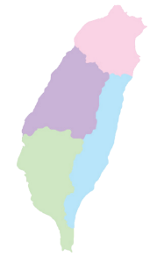
3. Taiwan’s Leading Industries Hand Tools
Industrial cluster
70% of the manufacturers is located in central Taiwan
Key manufacturers:
Sockets wrenches: Infar, Redai
Screwdriver: Lancer, Tong Lee
Hammer: Lucky tools
Saw: K&W; Pliers: Allpro
Power Tools: Basso, Durofix
Industry Scale
Production Value | US$4.1 Billion (2018) +2.03%
Export value | US$3.86 Billion (2018) +2.91%
Competitive products | Sockets, wrenches, hand tool kits, and pneumatic hand tools
Strengths | Industrial cluster Flexible manufacturing High quality products with good value Innovation
Industrial Trend | Digitized, lightweight, complex-functioned and environment-friendly products
Northern Taiwan
20%
Southern Taiwan
10%

Slide 43
3. Taiwan’s Leading Industries Hand Tools
TAITRA’s Trade Promotion Activities
Taiwan Industry Image Enhancement Project (IEP)
Taiwan Trade Digital and E-commerce Marketing
Image Enhancement
Outbound Activities: NHS, APPEX, Japan DIY Home
Center Show, IAAE, AAAE
Inbound Activities: AMPA Procurement Meeting,
Sourcing Taiwan Mid-Taiwan
E-commerce Platform: AMAZON Home Improvement Project
Market Development
Industry Survey: Market Information provided by Overseas Branch Offices (Australia, Japan, and Vietnam)
Market Seminar: Australian Hand Tools Market Forum, Japan Hardware and DIY Market Seminar
Market Research

Slide 44
3. Taiwan’s Leading Industries Fasterners
Taiwan Fastener Industry in 2018
Export Value | US$4.65 Billion (↑13.57%) | Import Value | US$153 Million (↑16.7%) |  | Global Ranking in Export Value | 3
Main Products | Screws and bolts, nuts, self-tapping screws |  |  | Number of Related Companies |  | 1,400
Trends | High added-value fasteners for automobile, medical, rails, aerospace, and green production
Main Export Markets
Key Players

Slide 45
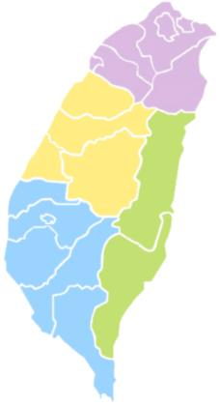
3. Taiwan’s Leading Industries Fasterners
The Strengths of Taiwan Fastener Industry
Complete Industry Cluster: Find suppliers of wire, tooling, machinery, fastener, surface treatment and packaging within 30 minutes.
1
Export-Orientation: Over 90% of fasteners made in Taiwan are exported. You can find almost all kinds of fasteners you need.
2
Flexible Production: Most Taiwan fastener suppliers are SMEs. They are dedicated to upgrading their technology, controlling costs, and providing better solutions.
3
Tainan & Kaohsiung

Slide 46
3. Taiwan’s Leading Industries Electric Vehicles
Sources: IEK, CTCI FOUNDATION

Slide 47
3. Taiwan’s Leading Industries Cultural & Creative
What We Focus On
Expand Taiwan’s cultural and creative industry to overseas markets
Facilitate development of Taiwan’s licensing industry in global markets
Crafts
Creative Design
Gaming & Animation
Business Model
Most Efficient Industry

Slide 48
3. Taiwan’s Leading Industries Cultural & Creative
Industry Overview
Year | 2013 | 2014 | 2015 | 2016 | 2017
Annual Turnover | 8,310 | 8,484 | 8,587 | 8,266 | 8,362
Growth Rate | 2.69% | 2.09% | 1.21% | -3.74% | 1.17%
Number of enterprises | 60,246 | 60,628 | 61,824 | 62,325 | 63,250
Growth Rate | 0.66% | 0.63% | 1.97% | 0.81% | 1.48%
2018 Taiwan Cultural & Creative Industries Annual Report
NTD/Billion
▲Turnover growth and increase in the number of enterprises

Slide 49
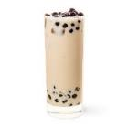
3. Taiwan’s Leading Industries Taiwan Bubble Tea
Raw Material
Packaging
Equipment
Total Solution
Chain Store
Value in 2016: 1.9bn 57m
Estimated Value in 2023: 3.2bn 14m
Annual growth rate: 7.4% within 7 years (2017-2023)
Franchise
Global Strategy
All “know how”
of running a Store
Liquid Filling Machine
Tea Maker
Sealing Machine
Tapioca in 2018 :
53.8M 59%
Cup
Straw
Bag
Unit: US$
Tea
Tapioca
Creamer
Syrup
The market share of bubble tea
in global consumed beverage in 2016: 42%
Source: Allied Market Research

Slide 50
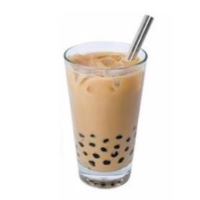
3. Taiwan’s Leading Industries Bubble Tea-2019 Key Plans
Marketing
Bubble Tea Pavilion
Seminars
Networking
Overseas:
1. Taiwan Expo in 5 countries 2019
2. Exhibitions 2019
Domestic:
1. Food Taipei
2. Food Kaohsiung
Topics:
Experience and knowledge share
Innovation in packaging and straw
1. KOL
2. YouTube
3. Line Group
4. Media Reports
1. 452 participants
2. Sourcing, info exchange
Request Topics
1. Provide local market info before expo
2. Invite local buyers & set up networking between exhibitors and buyers
3. Forward bubble tea pavilion info to local buyers

Slide 51
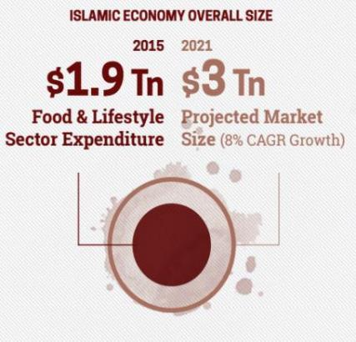
3. Taiwan’s Leading Industries Taiwan Halal
Feature
Nearly 700 companies with Halal certifications recognized by JAKIM.
Major Overseas Events
Malaysia International Halal Showcase and Food & Hotel Malaysia
Taiwan Expos in Malaysia, Indonesia and Philippines
Trade Meetings
Request Topics
Invite buyers and media to visit Taiwan Halal Pavilion in All events.

Slide 52
3. Taiwan’s Leading Industries Medical Care
World-class Medical Quality
2012
CNN rated Taiwan Medical Care
System as the Best World-Class Coverage
Taiwan – The Best Health Care System in the World
(The Richest Web 2014)
2014
2015
Quality of Death Index, 6th worldwide, 1st in Asia (EIU, 2015)
2018
14 medical service providers in Taiwan accredited by the JCI in 2018
Taiwan – The Best Health Care System in the World
(The Richest Web 2014)

Slide 53
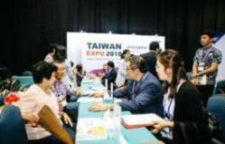
Taiwan’s Leading Industries Medical Care
Our Approach (Medical Care Industry Promotional Video)
01
.
Enhancing International Reputation With Successful Critical Care Cases
02
03
Providing O2O Platform
Design the Tailor-made Marketing Strategy at Home and Abroad

Slide 54
3. Taiwan’s Leading Industries Franchising
The service industry generates nearly 70% of Taiwan’s GDP. Over 60% of the population is in the service industry.
Franchise chain industry in Taiwan
Headquarters: 3,000
Total stores: 148,000
Outbound: 155 brands
Business model proportion
Department store
Wholesale
Supermarket
Franchise Store 55%
Direct-Sales Store 45%
Franchise chain industry in Taiwan
(proportion of different industries)
Source: 2018 Taiwan chain yearbook /2016 Taiwan Franchise Chain industry report

Slide 55
3. Taiwan’s Leading Industries Franchising
Domestic promotion activities:
International Franchising Seminar & Partnering Meeting
Customized business visit with Taiwan’s franchise brand
International Franchising Seminar & Partnering Meeting
Jan
Feb
Mar
Apr
May
June
July
Aug
Sep
Oct
Nov
Dec
Overseas promotion activities:
Thailand Franchise & Business Opportunities 2019
Malaysia International Retail & Franchise Exhibition, MIRF
Franchising & Business Opportunities Expo Melbourne
Taiwan Franchise Industry Trade Mission to Japan & Korea
Franchising & Licensing Asia, FLAsia
China Franchise Expo Wuhan
Nanjing International Franchise
Exhibition

Slide 56
Thank You

