Slide 1
Scientific Production Association "RYBTECHCENTRE"
We work worldwide!

Slide 2
Leader in engineering for fish-processing and food-canning industry in Russia
- OWN DESIGN BUREAU
- FISH-PROCESSING UNITS AND PRODUCTION LINES
- COMPLETE PRODUCTION CYCLE
- FROM PROJECT TO FACTORY
-EQUIPMENT MADE IN RUSSIA

Slide 3
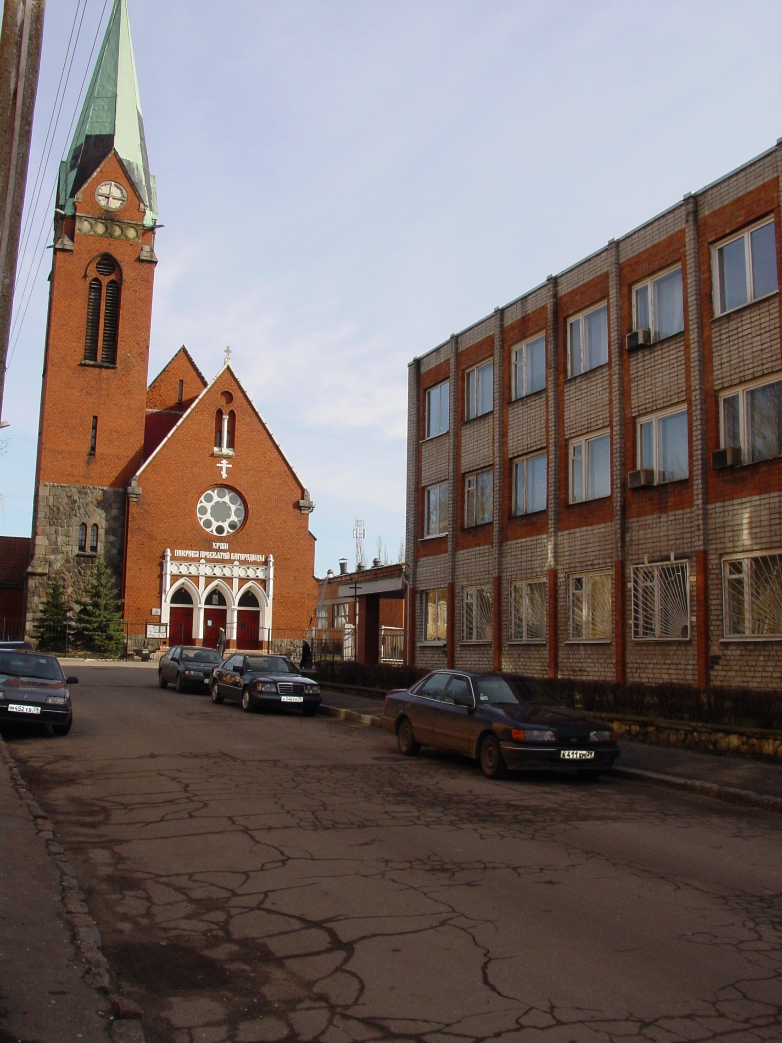
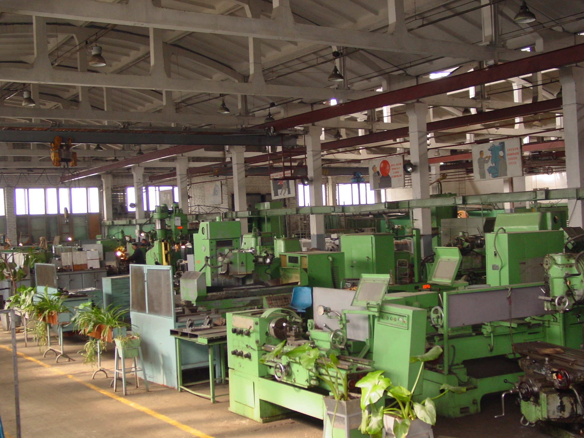
TECHNOLOGIES, QUALITY, SUCCESS!
Scientific Production Association "RYBTECHCENTRE" is a dynamically developing machine-building enterprise specializing in design and production of fish-processing equipment for fishing vessels and onshore factories, meat canning combines and other food industry facilities.

Slide 4
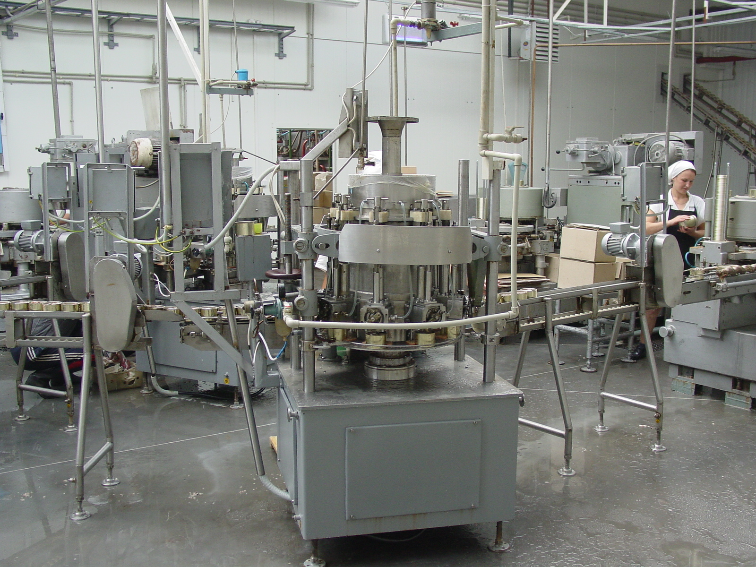
More than 55 years of successful operation
- More than 200 items of equipment developed
- We produce facilities for fish, meat, vegetable and canned food industry.
- Reliable solutions for your business.
- Guaranteed result.

Slide 5
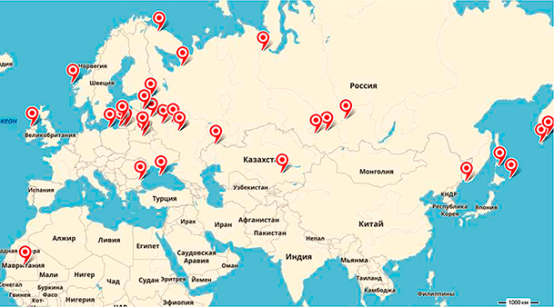
"RYBTECHCENTRE" today is No.1 in can-filling machine production.
Sales geography covers all of the Russian Federation and former Soviet states, including Baltic countries.
The equipment is supplied and successfully used in the European and African countries.

Slide 6
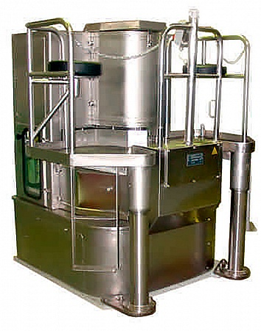
INA can-filling machines (INA-115, INA-125, INA-130) have unrivaled quality.
What is more, this equipment is suitable for canning fish into European Dingle and Сlab cans, as well as figured and plastic packaging.

Slide 7
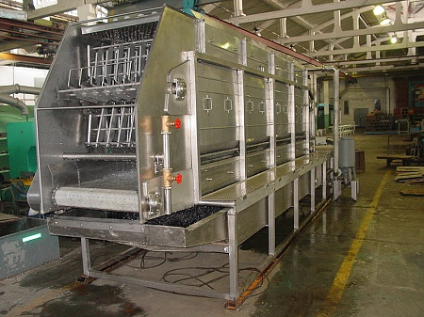
EQUIPMENT MADE IN RUSSIA
- defrosters;
-fish processing, batching, filleting and washing machines;
-fish scales and skin removers;
-can washers and dryers;
-salt, pate and oil applicators;
-blanching and frying machines;
-autoclave units;
-meatball molding machines and many more.

Slide 8
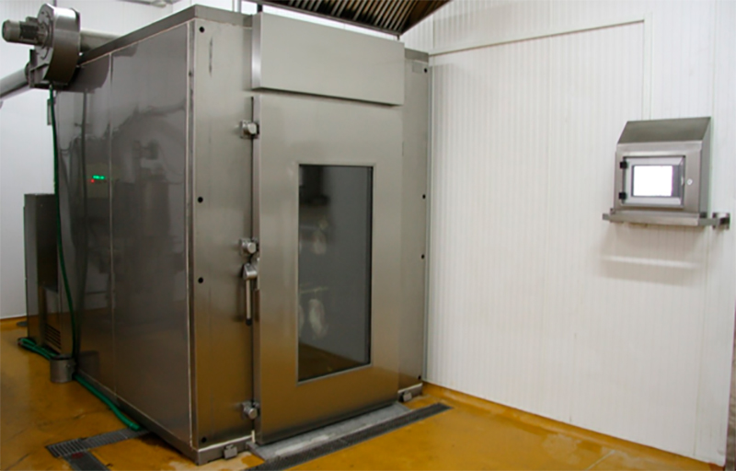
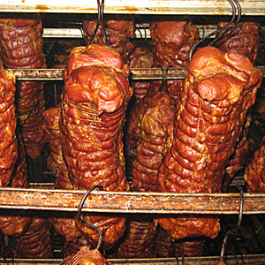
MULTIPURPOSE SMOKING CHAMBERS
A combination of a standard classical thermal smoking chamber and a fish smoking chamber (suitable for smoking of cheese and raw-smoking or raw-curing of meat)
With sawdust steam-generator unit, which gives the products the unique FLAVOR OF HOMEMADE SMOKE

Slide 9
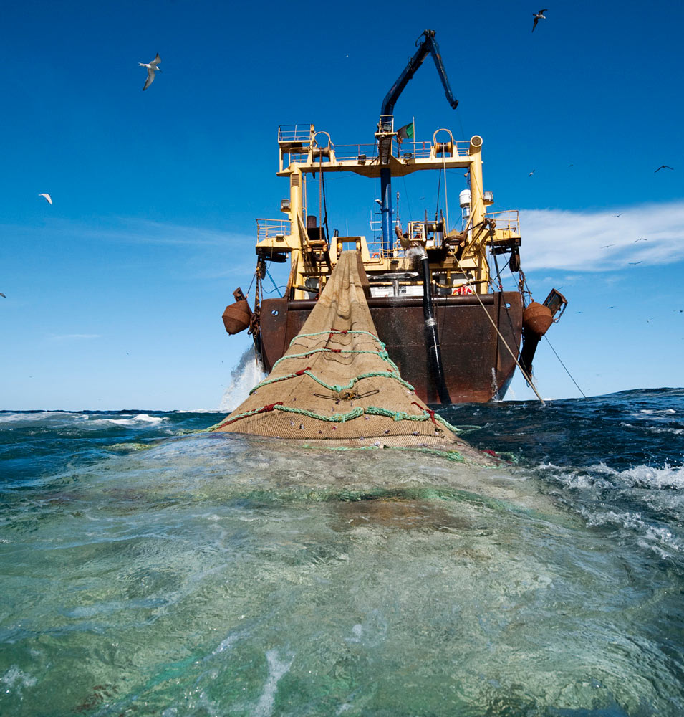
Today, "RYBTECHCENTRE" is actively engaged in the production of equipment for fish-processing on vessels:
Sorting, splitting and canning machinery; equipment for cleaning of cod liver of nematodes. Our engineers develop projects of upgrading options for fish-processing vessels for the purposes of canning on the Far East, which would significantly improve the quality of products made of fresh raw materials and the profitability of canned saury, ivory and pollock production.

