Slide 1
“Digital TV Systems”, your contract manufacturer
Saint Petersburg
2021

Slide 2








«GS Group» holding organization chart
Distribution
R&D center
innovation cluster GS
Service centers support
Product recycle
TECHNOPOLIS GS
Electronics utilization plant
SMT, THT, Product final assembly and testing
Cardboard and cast paper packaging production
FCF
DIGITAL TV SYSTEMS
Metal, plastic parts and LED-lightning systems production
In-house design and packaging center

Slide 3
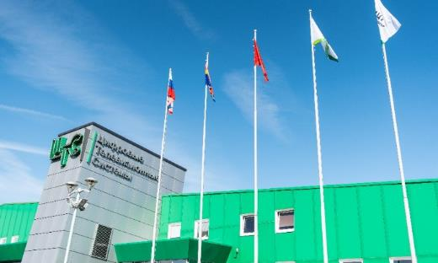
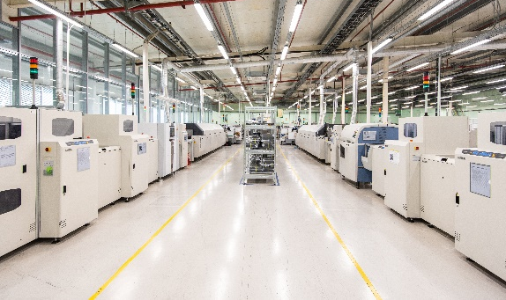
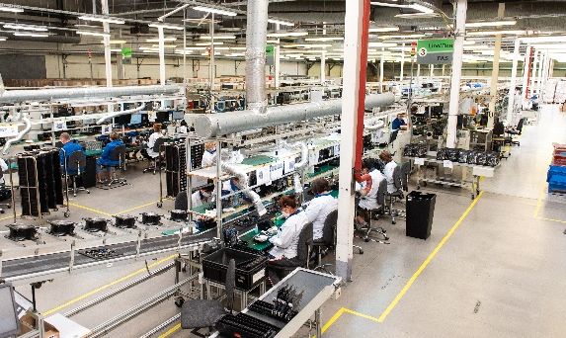
«Digital TV Systems» (DTVS)
«DTVS» is a key factory of «Technopolis GS», an innovative cluster and one of the largest production facilities in Europe for any types of electronics contract manufacturing:
«DTVS» in numbers:
Manufacturing capacity - 20 million of end-products per year
Work orders: from 500 pcs to mass-production series
Production area – 13 000 m²
570 employees
Certified by Quality Management System in accordance with ISO 9001:2015
Production areas are protected from static electricity in accordance with standards IEC 61340-5-1/2

Slide 4
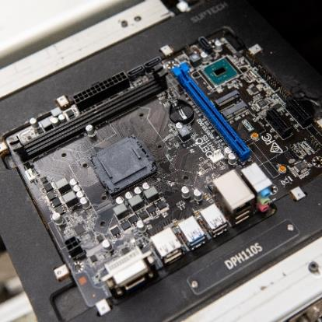
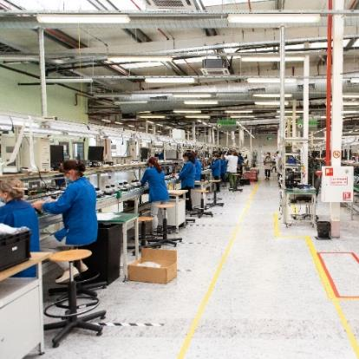
Localizing electronic manufacturing at «Digital TV Systems» factory
Areas of contract manufacturing: automotive, industrial electronics, telecom (STB, media hub etc.), measurement and security systems, devices for “smart home” and “smart cities”, medical equipment, smart meters, computer engineering etc.
“Technopolis” GS can place contract orders for the production of consumer electronics of any complexity level:
full cycle of production of electronic devices - from microcircuits to finished products packaging
qualified specialists
own R&D center
ability to independently procure components
modern industrial equipment
powerful production base for mass production
effective quality management practices

Slide 5
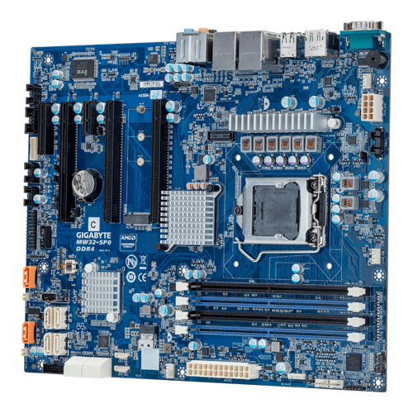


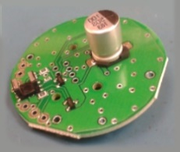
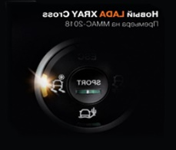
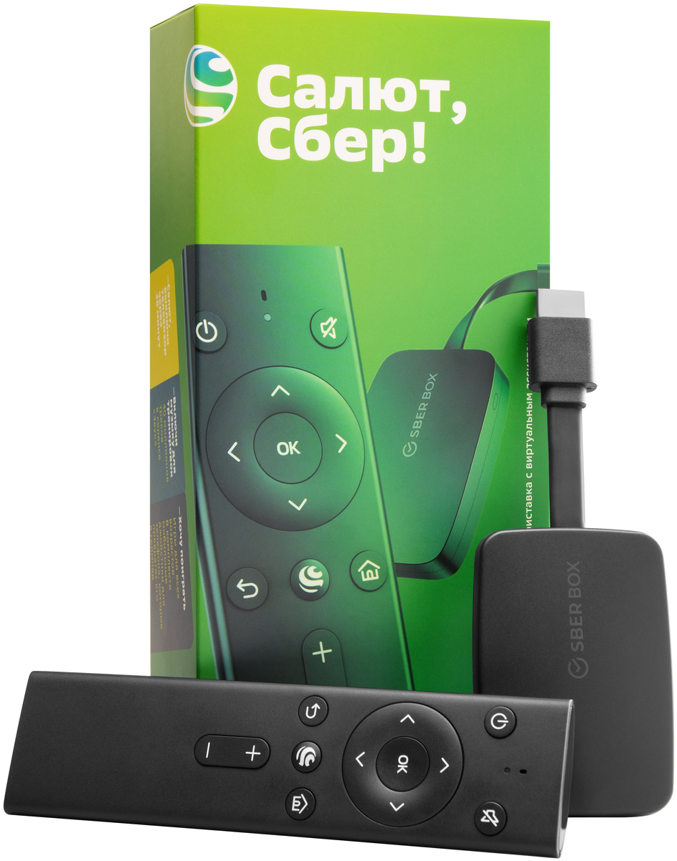
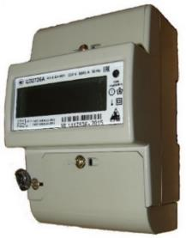
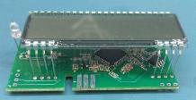
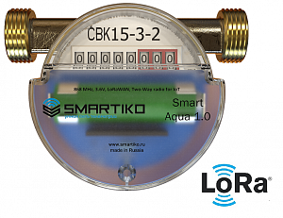
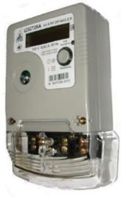
Portfolio of contract manufacturing:
Server and client motherboards for DEPO Computers
Automotive electronic components for LADA XRAY
Consumer electronics
Smart meters
SberBox
Electricity meters

Slide 6
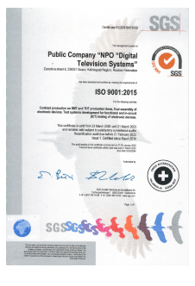
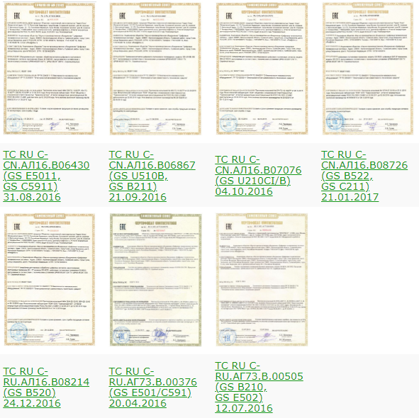
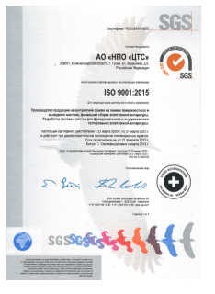
Certificates

Slide 7
What we can do for our customers:
Localize electronic production for the Russian market
Value:
Grants access to public procurement programs (B2G)
For companies:
a) producing electronics
b) planning to extend presence on the Russian market in B2G sector

Slide 8
Legal base
Government decree About confirmation of production of industrial output in the territory of the Russian Federation, number 719 (17th July2015)
For goods listed in the Supplement to the Resolution (Industries: machine tools, automotive, special machine building, photonics and lighting, electrical engineering and electric power, heavy machinery, medical devices, pharmaceutical, etc)
Requirements for the confirmation of being local:
Percentage of Russian electronic components use;
Russian Surface Mount Technology;
Russian assembly, packaging, testing;
And others.

Slide 9


















Our customers:
Notes:
До тог слайда фотослайд.

Slide 10
Sofya Ginzburg
Export Development Manager
s.ginzburg@spb.gs.ru
Mob: +7 904 385 15 91
4 Novoladozhskaya str., St. Petersburg, 197110, Russia

